Slide 1
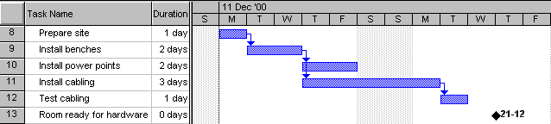
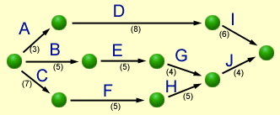
Having Fun with
Gantt
PERT
&
Modified from lecture notes of
Mark Kelly
McKinnon Secondary College

Slide 2
What are they?
Gantt and PERT charts are both “CPM” (Critical Path Method) tools to:
manage the tasks involved in big and complex projects
let project managers organise time, people, equipment and money
ensure the right people and equipment are in the right place and the right time
allow managers to monitor the progress of a project

Slide 3
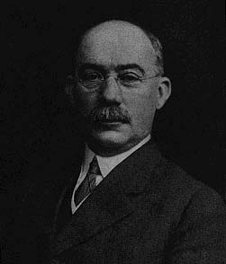
Gantt
Charts
Gantt
Charts
Henry Laurence Gantt (1861-1919)

Slide 4
Gantt Basics
Basically, a timeline with tasks that can be connected to each other
Note the spelling!
It is not all-capitals!
Can be created with simple tools like Excel, but specialised tools like Microsoft Project make life easier

Slide 5
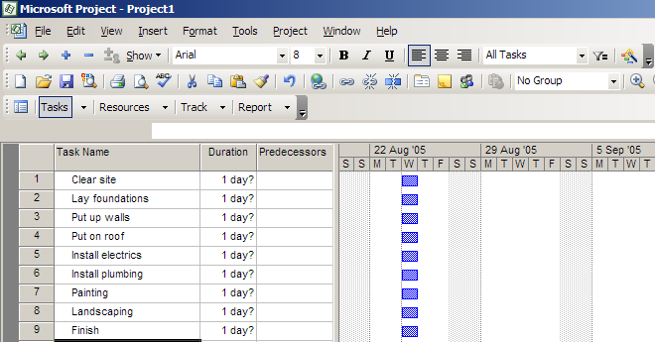
Making a Gantt chart
Step 1 – list the tasks in the project

Slide 6
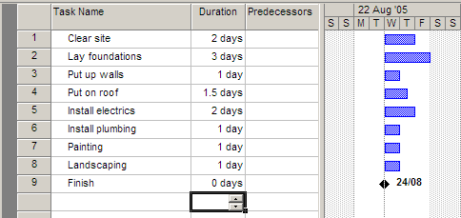
Making a Gantt chart
Step 2 – add task durations

Slide 7
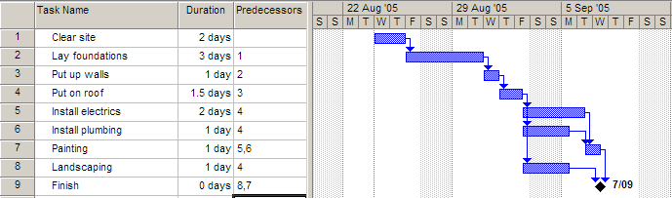
Making a Gantt chart
Step 3 – add dependencies (which tasks cannot start before another task finishes)

Slide 8
Notes
The arrows indicate dependencies.
Task 1 is a predecessor of task 2 – i.e. task 2 cannot start before task 1 ends.
Task 3 is dependent on task 2. Task 7 is dependent on two other tasks
Electrics, plumbing and landscaping are concurrent tasks and can happen at the same time, so they overlap on the chart. All 3 can start after task 4 ends.
Painting must wait for both electrics and plumbing to be finished.
Task 9 has zero duration, and is a milestone

Slide 9
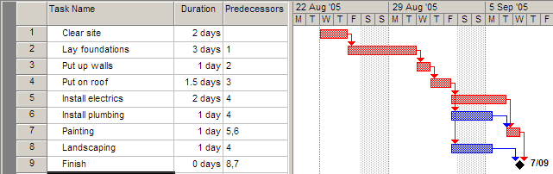
Making a Gantt chart
Step 4 – find the critical path
The critical path is the sequence of tasks from beginning to end that takes the longest time to complete.
It is also the shortest possible time that the project can be finished in.
Any task on the critical path is called a critical task.
No critical task can have its duration changed without affecting the end date of the project.

Slide 10
MS Project can work out the critical path for you!
The length of the critical path is the sum of the lengths of all critical tasks (the red tasks 1,2,3,4,5,7) which is 2+3+1+1.5+2+1 = 10.5 days.
In other words, the minimum amount of time required to get all tasks completed is 10.5 days
The other tasks (6,8) can each run over-time before affecting the end date of the project

Slide 11
The amount of time a task can be extended before it affects other tasks is called slack (or float).
Float = Late Start – Early Start OR Late Finish – Early Finish
Task 6 can take an extra day and a half before it affects the project’s end date, so each has 1.5 day’s slack.

Slide 12
Critical tasks, by definition, can have NO slack.
Thus if you are ever asked, “Can the duration of a critical task be changed without affecting the end date of the project?”, the answer is always NO!

Slide 13
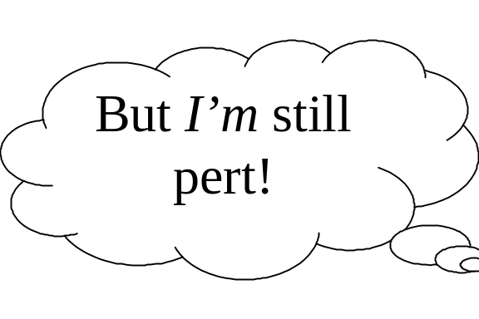
PERT
Charts
PERT
Charts
Not named after Mr Pert!
Stands for Program Evaluation and Review Technique

Slide 14
PERT basics
PERT is an acronym so it’s in capital letters
Gantt is a name, so only has an initial capital
In Gantt chart, the length of a task’s bar is proportional to the length of the task. This rarely applies to PERT charts.
There are a few different “flavours” of PERT and Gantt charts…

Slide 15
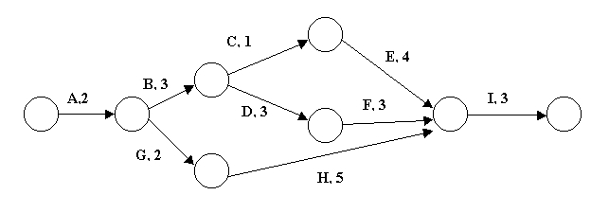
PERT charts
This PERT chart follows the “Activity on Arrow” style.
The tasks are shown by arrows. Task name are shown by letters, in this case.
The circles are called nodes. The nodes indicate the start or end of tasks.
Task durations are the shown by the numbers.

Slide 16
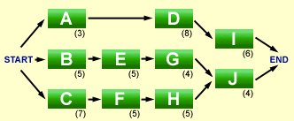
‘Activity on Node’ style PERT
Activity on Node is a different flavour of PERT: this time the nodes are tasks, and the arrows are merely connectors. We will use Activity on Arrows, with the nodes merely connecting points. It’s a style issue!

Slide 17
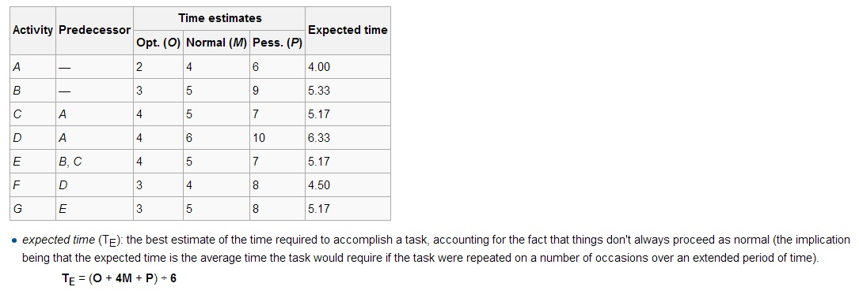
Sidebar…

Slide 18
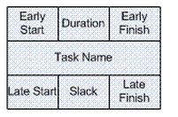
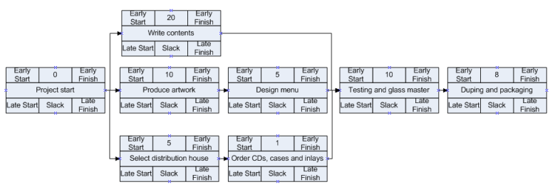
Network Activity Diagram

Slide 19
Early Start – The earliest time that an activity can start
Early Finish – The earliest time that an activity can finish
Late Start – The latest time that an activity can start
Late Finish – The latest time that an activity can finish

Slide 20
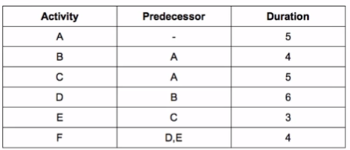

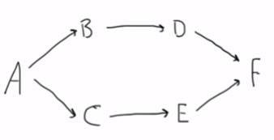
Example: Activity Network
Software Engineering

Slide 21

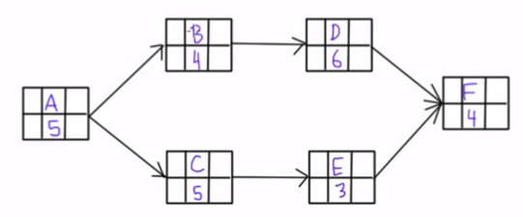
Example: Activity Network
Software Engineering

Slide 22
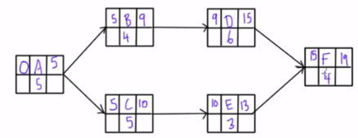
Example: Activity Network- Early Start and Early finish
A,B,D,F = 5+4+6+4=19
A,C,E,F= 5+5+3+4= 17
Therefore, ABDF is critical path
Software Engineering

Slide 23

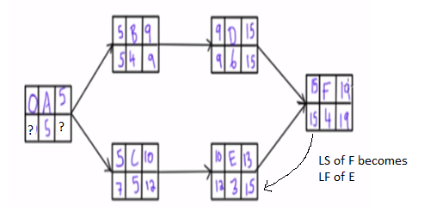
Example: Activity Network- Late Start and Late finish
Software Engineering

Slide 24

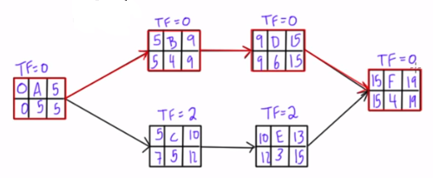
Example: Activity Network- Total Float(Slack)
Total float is how long an activity can be delayed, without delaying the project completion date. On a critical path, the total float is zero.
Total Float=TF
TF=LS-ES OR TF=LF-EF
Software Engineering

Slide 25


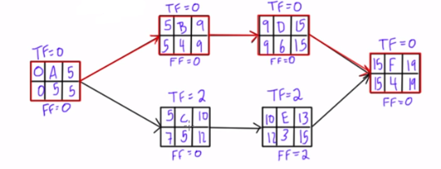
Example: Activity Network- Free Float(Slack)
Free float is how long an activity can be delayed, without delaying the Early Start of its successor activity.
Or FF= ES(successor) – EF (activity)
Software Engineering

Slide 26
Some terminologies
Buffer also referred to as Schedule Margin, Schedule Buffer, Contingency, Reserve, etc... is an activity or period of time that is strategically placed on the Critical Path, typically prior to the agreed upon completion or delivery date.
Lead
The amount of time whereby a successor activity can be advanced with respect to a predecessor activity.
Lag
The amount of time whereby a successor activity is required to be delayed with respect to a predecessor activity.

Slide 27
Credits
Mark Kelly, McKinnon Secondary College
Lecture Notes

